Slide 1
Revamp the activities! General meeting– February 27, 2024
Università degli studi di Milano (umil)

Slide 2
Agenda
Major changes in the amendment
New partners
WPs, Deliverables, Tasks
Revamping the activities
WP4: Selecting core Cyber Range infrastructure
WP3: Define CRSA models to support CR instancing and start thinking to training scenarios (CRST)
WP5: Start thinking on integration (server installation) and pilots’ validation
Financial Information

Slide 3
Amendment
Inclusion in the Consortium of two new partners
Ethical AI (Cyprus) - Academic – 5 secondments (60 PM)
Trinomial (Cyprus) – Non-academic – 5 secondments (60 PM)
Ethical AI will take responsability of WP3 «AERAS Models & Model-driven Cyber Range programmes creation»
Trinomial will take responsibility of WP5 «Platform Integration, Pilots, and Validation»
NO further extensions, project will end at M66

Slide 4
WP3: AERAS Models & Model-driven Cyber Range programmes creation
D3.1 CRSA Models and CRSA-driven Cyber Range programme specification language M54 – Leader EAIN
D3.2 AERAS Models and CRSA-driven Cyber Range programme V1 M58 – Leader TRID
D3.3 AERAS Models and CRSA-driven Cyber Range programme V2 M66 – Leader EAIN
Task 3.1 CRSA language definition and tool support - M06-66: Leader: EAIN
Task 3.2 CRSA-driven Cyber Range program development - M09-66: Leader: TRID
Task 3.3 Adaptation of CRSA models to changes in threat landscape - M09-66: Leader: EAIN
Task 3.4 Hybrid Cyber Security Risk Analysis Models - M09-66: Leader: TRID

Slide 5
WP4 Key Components Development
D4.1 AERAS Cyber Range Tools - V1 M54 – Leader CUT
D4.2 AERAS Monitoring, Assessment and Adaptation mechanisms - V1 M54 – Leader UMIL
D4.3 AERAS Cyber Range Tools – V2 M66 – Leader AEGIS
D4.4 AERAS Monitoring, Assessment and Adaptation mechanisms – V2 M66 – Leader UMIL
Task 4.1 Cyber Range & Simulation tools - M09-66: Leader: CUT
Task 4.2 Visualisation tools - M09-66: Leader: AEGIS
Task 4.3 Real time trainee assessment & Cyber Range programmes Evaluation - M09-66: Leader: UMIL
Task 4.4 Real time Cyber Security Assurance Models, and CSLA monitoring - M09-66: Leader: CUT
Task 4.5 CRST programmes adaptation mechanisms M09-66: Leader: UMIL

Slide 6
WP5 Platform Integration, Pilots, and Validation
D5.1 Initial Prototype of integrated AERAS platform M56 – Leader TRID
D5.2 AERAS Evaluation Framework and Pilot Set Up Guidelines M56 – Leader UMIL
D5.3 AERAS initial prototype pilot validation report M60 – Leader UPAT
D5.4 Final Prototype of integrated AERAS platform M66 – Leader TRID
D5.5 AERAS final prototype pilot validation report M66 – Leader PAGNI
D5.6 Final AERAS evaluation report M66 – Leader UMIL
Task 5.1 Integration of tools and components and testing of integrated AERAS platform - M24-62: Leader: TRID
Task 5.2 Pilots Evaluation Methodology & Setup - M24-62: Leader: UMIL
Task 5.3 Pilot validation - Smart Hospital Environment - M28-66: Leader: UPAT
Task 5.4 Pilot validation - Healthcare Authority - M28-66: Leader: PAGNI

Slide 7
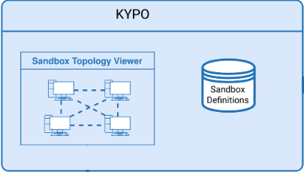
WP4 core architecture
GIT Repo
CRSA-CRST
Proposal of using Kypo Standalone version as core Cyber Range infrastructure (open ti discussion)
Investigate how we can extend it with AERAS specific components and models
Study Kypo’s endpoints to manage the infrastructure from AERAS interface
Cyber System Risk Evaluator
Cyber System Monitor
Submodels Extractor
Visualization
Performance Evaluator
Programme Evaluator
AERAS INFRASTRUCTURE

Slide 8
WP4 upcoming Deliverables
D4.1 AERAS Cyber Range Tools - V1 M54 Focus on:
Selection of the core architecture
Study on KYPO endpoints and how to access them to instance the trainign environments
Definition of the main communication flows
Definition of the main data exchange among modules
D4.2 AERAS Monitoring, Assessment and Adaptation mechanisms - V1 M54 Focus on
Definiton of the main properties on trainees’ perfomrmance and cyber-system specific characteristics
Definition of the methodologies used to monitor
Use of CRSA models in the monitoring activities

Slide 9
WP3 Core models
AERAS models:
CRSA models specify potential cyber-attacks, the security mechanisms used against them, and the methods for assessing their effectiveness
CRST models define training scenarios, directly connected with the security threats they want to focus on, specifying the type of training we want to execute
Questionnaire-based: questions, possible answers, type of questions…
Interactive using cyber range: type of VMs to deploy, virtual topology, type of exercise to request to trainees
Mixed: questionnaires and VMs
AERAS modules and Kypo based on models to deploy the training activities
The Submodels Extractor should extract from CRSA and CRST specific for a training activity the specific submodel needed for a specific module to run

Slide 10
WP3 upcoming deliverables
D3.1 CRSA Models and CRSA-driven Cyber Range programme specification language M54 Focus on
Definition of CRSA structure
Definition of CRST structure
Specification of submodels w.r.t. AERAS and KYPO modules

Slide 11
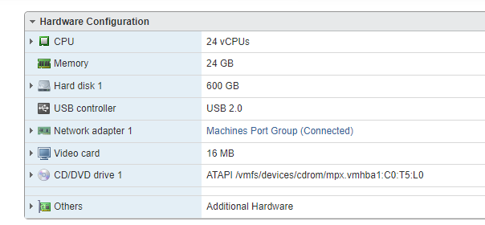
WP5 Integration and evaluation
Installation of a first testing environment
Based on Openstack (to be instaleld and configured)
Running a Kypo instance
A server at UMIL is available for testing purposes
Definition of the base evaluation techniques for the pilots

Slide 12
WP5 Upcoming deliverables
D5.1 Initial Prototype of integrated AERAS platform M56 Focus on
Report on the first testing installation to be then replicated in Pilots’ premises
Description of first installation steps
D5.2 AERAS Evaluation Framework and Pilot Set Up Guidelines M56 – Leader UMIL
Defintion of the set of KPIs, criteria and methodology to evaluate the AERAS platform.
Provide guidelines and documentation to support the piloting phase

Slide 13
Financial information
Total Budget: 1.435.200,00 €
Paid by EC (85%): 1.219.920,00 €

