Slide 1
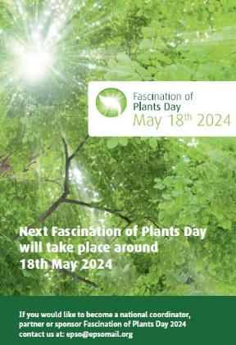
EPSO fosters science with society approaches
Fascination of Plants Day (FoPD)
FoPD 2022: > 810 events in over 54 countries https://plantday18may.org/
FoPD 2024: 59 countries already confirmed
Launch on 15.12.2023
Get inspired by the success stories FoPD 2022
– published 28.2.2023
Prepare and hold interactive inspiring events on FoPD 2024
around 18 May 2024
Activities can happen from
March to November 2024,
peak in May.
Notes:
Normally describing the fire escapes and where the toilets are.
This time:

